Slide 1
What is Biosecurity?
Amanda Hodges, Ph.D.
Entomology/Nematology Dept.
University of Florida
Exotic Species & Biosecurity Issues ENY 4161/6166

Slide 2
What are the Issues?
Photo Credit: Stephen Ausmus, USDA ARS
http://www.ars.usda.gov/is/graphics/photos/ , Image No. D001-1
Notes:
Have you ever worried about not having freely available and affordable whole grain products that provide your daily fiber? Most children and adults should plan to consume 20 grams per day of dietary fiber. Whole grains, as well as some fruits and vegetables and legumes in particular, are good sources of dietary fiber. Researcher has also shown that a diet inclusive of whole grains reduces heart disease, diabetes, diverticular disease, and constipation.
Source of Information: Harvard School of Public Health, The Nutrition Source, Fiber: Start Rouging It!
http://www.hsph.harvard.edu/nutritionsource/what-should-you-eat/fiber-full-story/index.html

Slide 3
What are the Issues?
Photo Credit: Peggy Greg, USDA ARS
http://www.ars.usda.gov/is/graphics/photos/, Image No. K9093-1
Notes:
Have you ever considered not having available and affordable fruits, vegetables, and dairy products.

Slide 4
What are the Issues?
Photo Credit: Peggy Greg, USDA ARS
http://www.ars.usda.gov/is/graphics/photos/ , Image No. K9093-1
Notes:
Do you ever think about the farming industry, both in the U.S. and international, that provides the food available to you in the grocery store, or on a favorite menu item in a restaurant. What happens if there is a catastrophic loss of a crop or commodity that we use every day? Would this impact our economy? Would our ability to affordably purchase food change? With pest pressures and fluctuations in market needs and prices for commodities, farming can be a challenging career path. In fact, since World War II, the number of farms in the U.S. has been on the decline. In 2002, the number of small farms slightly increased by 4%. Currently, the number of farms appears to be relatively level. In increased emphasis on small farms has occurred in some areas. From 2002-07, U.S. farmers sold $297 billion and invested $241 billion in production costs. On average, this represents a 19% profit margin for the farmers. Although farming on average in the U.S. continues to be profitable, many of the profit margin ratios are represented by larger scale operations.
Sources of Information:
USDA NASS. 2007 Trends in American Agriculture http://www.nass.usda.gov/research/sarsblog/Wade_AAG10_AgTrends1.pdf
USDA ERS. 2005. Farm Income and Financial Performance. 2005 Family Farm Report/EIB-12 http://www.ers.usda.gov/publications/EIB12/EIB12d.pdf

Slide 5
Did you Know?
2002, agriculture industries contributed to 11% of the U.S. Gross Annual Domestic Product (GDP)
Value of $1.3 trillion dollars
Approximately 50% of all U.S. land is used for agriculture or forestry
Notes:
184 million hectare for crops and 284 million hectare as forestland.
Source of Information: Gullino, M.L., J. Fletcher, and J.P. Stack. Crop Biosecurity: Definitions and Role in Food Safety and Food Security. 2008. In Crop Biosecurity: Assuring our Global Food Supply. Gullino, M.L., J. Fletcher, A. Gamliel, J.P. Stack (eds). Springer. Pp. 1-10.

Slide 6
Did you Know?
2007: First time in history that urban populations are larger than rural.
World population estimated at greater than 9 billion by 2050.
Global poverty alleviation is dependent upon agriculture.
Photo Credit: Amanda Hodges, University of Florida
Urbanization-Lagos, Nigeria
Notes:
Did you know that a historical event recently happened for agriculture? For the first time in history, urban population numbers are larger than rural populations. As more land is developed for urbanization, agricultural land in production must continually and efficiently produce a larger quantity of food. It is estimated that the world population by 2050 will exceed 9 billion people. How will the global community be able to continually feed the world while land designated for agricultural production continues to diminish? The agricultural sector must continually seek to meet increasing population demands, appropriately use water and other natural resources, and provide a nutritious and safe food supply to the consumers. Although agricultural production is declining, agriculture continues to be an occupation and/or sustenance living strategy for the largest number of people worldwide. Worldwide, development and support of the agricultural sector in terms of maximizing their agriculture for efficiency of production and for the economic benefit of their farmers is a key factor for poverty alleviation.
Source of Information: Agricultural Ecosystems: Facts and Trends. 2008. World Business Council for Sustainable Development and the International Union for Conservation of Nature. http://www.wbcsd.org/DocRoot/hecbd2TCBtPqRBOGXoi2/AgriculturalEcosystems.pdf

Slide 7
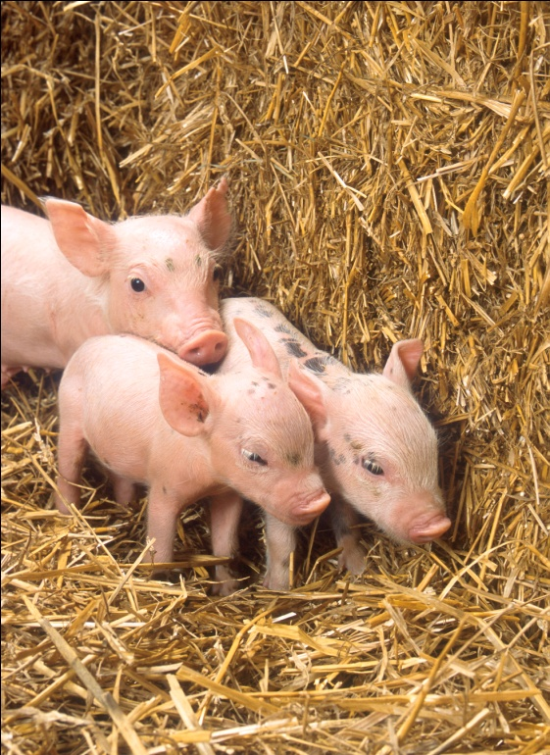
Did you Know?
Increased wealth results in a higher demand for diverse diets, including various meats, fruits, and vegetables.
Grain production uses less water.
Photo Credit: Image (left) Keith Weller, USDA ARS, Image No. k8339-3; Image (right) Scott Bauer, USDA, ARS, Image No. k9455-1http://www.ars.usda.gov/is/graphics/photos/,
Notes:
Did you know that as a country’s wealth increases, so does the demand for more diverse diets that include meats, fruits, and vegetables. For example, China has doubled their meat consumption in the last 20 years, and they are reducing their field crop acreages. Currently, China is a world leader in the production of vegetables and apples. Producing meat, fruit, and vegetable commodities typically requires more water than grain production. Also, animal agriculture competes for some of the grain products that could be used for human consumption. The availability of clean water for agricultural production is an issue. Water is a limited factor due to drought stress, climate change, and competition with urban populations. On average, 80%-90% of freshwater supplies in developing countries are devoted to agriculture.
Source of Information: Agricultural Ecosystems: Facts and Trends. 2008. World Business Council for Sustainable Development and the International Union for Conservation of Nature. http://www.wbcsd.org/DocRoot/hecbd2TCBtPqRBOGXoi2/AgriculturalEcosystems.pdf

Slide 8
What are the Issues?
Agricultural Productivity
Consumer Cost and Demand
Urbanization
Market Value of Agricultural Commodities
Food Security and Safety
Water Use
Minimizing environmental impact
Notes:
So in summary, some of the issues that are affecting plant production today include 1) an increased demand for improved, efficient, agriculture 2) consumer cost for food needs to be affordable, particular to poorer individuals 3) urbanization increases the demand for food and has the potential to increase food costs 3) agricultural needs to be a profitable choice for farmers, and the market value of agricultural commodities continues to have an impact on the agricultural sector 4) food security and food safety refers to both the risk of pathogen and/or pest introduction on the farm as well as the potential contamination of the food supply with bacteria or other pathogens before it reaches the consumer 5) conservation and use of water is important in agricultural production systems and 6) a minimal environmental impact for implemented pest management strategies implemented.

Slide 9
Biosecurity- Is America’s Food Supply Safe?
Related to U.S. and international agricultural production issues.
Economic and social impacts of a plant-production based bioterrorism attack would be devastating.
Photo Credit: Scott Bauer, USDA ARS
http://www.ars.usda.gov/is/graphics/photos/, Image No. k8991-1
Notes:
Consider this question-do you think America’s food supply is safe? Although invasive species in natural ecosystems can be quite costly and devastating, the term biosecurity is often used interchangeably with agricultural biosecurity. Consequently, biosecurity in the U.S. is closely connected to both the U.S. and international agricultural production issues that we have discussed. Most of the invasive species introductions that have affected U.S. agricultural have occurred through accidental or unintentional pathways. Increased international trade of various plant-based commodities or products that could harbor plant pests and human travel have significantly affected the occurrence of new pest introduction in the U.S. Although accidental pathways are common, the possibility of a purposely introduced plant pathogen or pest as a bioterrorism agent does exist. If such an event were to occur, the economic and social impacts would be devastating. Starvation and famine could occur in the U.S. and elsewhere in the world where populations depend upon either our agricultural commodities or food-based humanitarian aid.

Slide 10
What If…
USDA-ARS Photo Gallery, Image No. k1441-5
http://www.ars.usda.gov/is/graphics/photos/
Notes:
What would happen if our U.S. wheat production were attacked by a disease or pest such as-

Slide 11
Wheat Stem Rust Ug99
What?
Wheat lines with the Sr31 resistance gene found to be infested
Where?
Uganda, Africa 1999
Impact?
First worldwide report of virulence to the Sr31 gene
USDA-ARS Photo, Wheat Stem Rust
http://www.ars.usda.gov/Main/docs.htm?docid=9910
Notes:
Wheat stem rust (caused by the parasitic fungus Puccinia graminis) has been a major problem for wheat throughout history, destroying entire fields in countries around the world. Once infected with the rust, the wheat produces shriveled seeds or no seeds at all, thus preventing people from making flour (and therefore bread) causing mass shortages of this food staple. In 1970, wheat varieties that were resistant to wheat stem rust were developed by incorporating the Sr31 gene into their genome. This gene provided the wheat the resistance it needed against wheat stem rust and helped increase wheat production throughout the world in countries such as India, China, Europe, and South America where it was planted. However, in Uganda, Africa, in 1999, a new virulent race of wheat stem rust (Puccinia graminis f. sp. tritici Pgt-Ug99) was discovered to which the new wheat varieties were not resistant. This stem rust strain is referred to as ‘Ug99’. As a result, 80% of the world’s wheat is now potentially susceptible to Ug99.
Following the outbreak of wheat stem rust in Uganda, similar virulence reports occurred in Kenya (2001) and Ethiopia (2003). Race typing confirmed the presence of Ug99 in Kenya (2005). Ug99 also spread to Iran in 2008. It is anticipated that the pathogen may spread by natural (wind) or other means (travelers) to Europe, India, and China in the near future.
Source of Information: USDA-ARS http://www.ars.usda.gov/Main/docs.htm?docid=14649
Source of Information: IAEA http://www.iaea.org/NewsCenter/News/2009/stemrust.html
Did you know?
1. The United States is a major wheat-producing country, with output typically exceeded only by China, the European Union, and India.
2. Wheat ranks third among U.S. field crops in both planted acreage and gross farm receipts, behind corn and soybeans.
Source of Information: http://www.ers.usda.gov/Briefing/Wheat/

Slide 12
Sunn Pest, Eurygaster integriceps
Photo Credit Left: ICARDA, FAO Plant Protection Series 2002
Bread Wheat: Improvement and Production, Curtis BC, Rajaram S,
Gómez Macpherson (eds.) http://www.fao.org/DOCREP/006/Y4011E/Y4011E00.HTM
Photo Credit Right: Florida Department of Agriculture and Consumer Services – Division of plant Industry
Notes:
The sunn pest (or suni bug) (Hemiptera; Pentatomidae) has sometimes been referred to as the world’s ‘worst agricultural pest’. It is a devastating pest of wheat- the world’s most important food grain source for humans. Although wheat is the preferred host of concern, barley, rye, oats, sorghum, and maize may also be infested. The sunn bug does not occur in North America, and its current distribution includes southern and eastern Europe, northern Africa, as well as southwestern and south-central Asia. The most severe outbreaks have occurred in Asia minor, northern Syria, Iraq, and Iran. One nymph can kill a young wheat tiller (the side shoots of the wheat plant that produces about 70% of the grain or seed). The sunn bug feeds on developing wheat heads and secretes an enzyme that kills the kernels. If a sunn bug feeds on a developing wheat head, the part of the head above the feeding site dies. As little as 8% damage to kernels can make flour worthless for baking. Most countries with established populations of the sunn bug have resorted to chemical-based control strategies for management.
Source of Information: Susan Halbert (FDACS-DPI); Miller RH, Pike KS. 2002. Insects in wheat-based systems. In. Bread Wheat: Improvement and Production. In FAO Plant Production and Protection Series. 567 pg.Curtis BC, Rajaram S, Gómez Macpherson (eds.). http://www.fao.org/DOCREP/006/Y4011E/Y4011E00.HTM (16 February 2010)

Slide 13
Wheat Losses-Who’s Affected?
Developing countries
Food animal producers
Everyone
Photo: Jean Robinson, Gainesville, FL
Source of chart: Food and Agriculture Organization of the United Nations 2010 http://www.fao.org/hunger/en/
Notes:
Wheat is a staple food commodity, for people and animals. For 2009/2010, the U.S. alone projects using 940 million bushels of wheat for food use, 72 million bushels in seed use, and 170 million bushels in feed and residual use. Also for 2009/10, the U.S. projects that 825 million bushels of wheat will be exported. Worldwide wheat production for 2009/10 is anticipated to be at 645.6 million tons. In poor developing countries, families may spend 60% of their income on food. As the cost of food rises and food becomes more scarce, malnutrition and starvation increases. The food insecure (i.e. individuals that may not have a reliable or affordable source of food) would be most impacted by a wheat loss crisis; however, everyone would be impacted. Remember that staple crops, such as wheat, are also important sources for feeding food animals (and possibly pet animals in some cases).
Wheat statistical information obtained from the USDA ERS (www.ers.usda.gov) Wheat Outlook, February 12, 2010 by G. Vocke, E. Allen, and O. Liefert. http://usda.mannlib.cornell.edu/usda/ers/WHS//2010s/2010/WHS-02-12-2010.pdf

Slide 14
Objectives
Understanding Biosecurity Issues
Terminology
Acronyms
Example Select Agents
Where have Agricultural Bioweapons Programs Existed?

Slide 15
Introductory Terminology
Biosecurity: preparing for a pest introduction, natural disaster, or other situation that may result in a catastrophic event to biological organisms.

Slide 16
Introductory Terminology
Agroterrorism: the purposeful destruction of an agricultural commodity with the intent to cause fear, panic, or substantial economic loss to a region.

Slide 17
Introductory Terminology
Food Safety: preventative farm and post-production practices that reduce the risk of harm to the consumer of an agricultural commodity.

Slide 18
Acronyms
SPS
NAFTA
USDA
APHIS
WTO
FBI
PPQ
CDC
SDA
HHS
WHO
FDACS-DPI

Slide 19
Introductory Terminology
Select Agents and Toxins:
“The Public Health Security and Bioterrorism Preparedness and Response Act of 2002, Subtitle A of Public Law 107–188 requires the Department of Health and Human Services (HHS) to establish and regulate a list of biological agents and toxins that have the potential to pose a severe threat to public health and safety.”
.
Information Obtained from the National Registry of Select Agents
http://www.selectagents.gov/Select%20Agents%20and%20Toxins.html

Slide 20
Introductory Terminology
Select Agents and Toxins:
“The Agricultural Bioterrorism Protection Act of 2002 requires the United States Department of Agriculture (USDA) to establish and regulate a list of biological agents that have the potential to pose a severe threat to animal health and safety, plant health and safety, or to the safety of animal or plant products (Select Agents).”
Information Obtained from the National Registry of Select Agents
http://www.selectagents.gov/Select%20Agents%20and%20Toxins.html

Slide 21
Introductory Terminology
. Select Agents and Toxins:
CDC and APHIS share responsibility for some select agents
HHS and USDA required to complete a biennual review of the list
Information Obtained from the National Registry of Select Agents
http://www.selectagents.gov/Select%20Agents%20and%20Toxins.html

Slide 22
HHS Only Select Agents and Toxins
26 as of May 2010

Slide 23
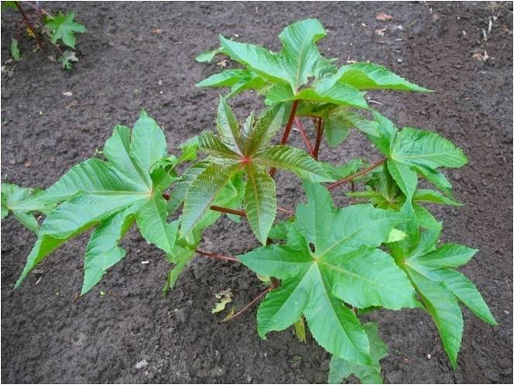
Ricin
Poison found naturally in castor beans.
Powder, mist, pellet, or dissolved in water/weak acid.
Prevents cells from making proteins.
Photo Credit: Marc Ryckaert, Creative Commons Attribution 2.5 License, Wikipedia
Notes:
Ricin can be made from the waste material left over from processing castor beans. Castor beans are processed throughout the world to make castor oil. Ricin is a component of the waste ‘mash’ that is produced. Has been used on an experimental basis to attempt to kill cancer cells. Accidental exposure is only through swallowing castor beans. Poisoning by ricin would take a deliberate act. Ricin could be used as a terrorist warfare mechanism to expose people by air, food, or water. In 1978, Georgi Markov, Belgian writer and journalist living in London, was attached by a man who had rigged an umbrella to inject him with a poisonous pellet. In the 1940’s the U.S. experimented with the use of ricin as a bioweapon. Reports also suggest that ricin was used by Iraq in the 1980’s, and possibly in more recent terrorist attacks as well.

Slide 24
Ricin Symptoms
Inhalation: respiratory distress, fever, cough, nausea, and tightness in the chest. Low blood pressure, respiratory failure, and death may result.
Ingestion: Vomiting and diarrhea that is bloody, severe dehydration, low blood pressure, hallucinations, seizures, and blood in the urine.
Notes:
Inhalation symptoms typically occur within 8 hours. Symptoms of digesting ricin typically occur within 6 hours. With those that have inhaled ricin, heavy sweating may follow as well as fluid build-up in the lungs. The skin might also turn blue. Individuals with respiratory failure within 12 hours of suspecting that they have inhaled ricin should seek immediate medical attention. After a few days of ingesting ricin, the liver, spleen, and kidneys might stop working, resulting in death. Ricin is not likely to be absorbed through skin (i.e. unless that skin has an open wound). Contact with ricin powders or products may result in redness and pain of the skin and eyes. Death from ricin typically occurs within 36 to 72 hours, depending upon dosage and exposure.

Slide 25
Overlap Select Agents and Toxins
10 as of May 2010

Slide 26
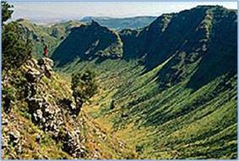
Rift Valley Fever Virus (RVF)
Identified 1931
Outbreak in sheep in the Rift Valley, Kenya
Subsequently outbreaks occurred in sub-Saharan and North Africa
Photo Credit: http://kenya.lodgesafari.com/images/kenya-great-rift-valley.jpg
Notes:
In 2000, reports in Saudi Arabia and Yemen were the first outside of Africa.

Slide 27
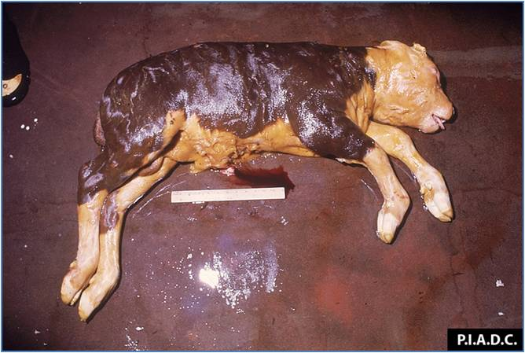
Rift Valley Fever Virus (RVF)
Cattle, sheep, camels, and goats.
Over 90% of lambs affected die.
Spread of the disease among animals is primarily by Aedes mosquitoes.
Photo Credit: http://www.cfsph.iastate.edu/DiseaseInfo/ImageDB/RVF/RVF_001.jpg
Notes:
Sheep appear to be the most susceptible. Age is a factor in animal susceptibility. A wave of abortions in livestock often signals the beginning of an epidemic. Outbreaks of RVF can be prevented by a sustained animal vaccination program.

Slide 28
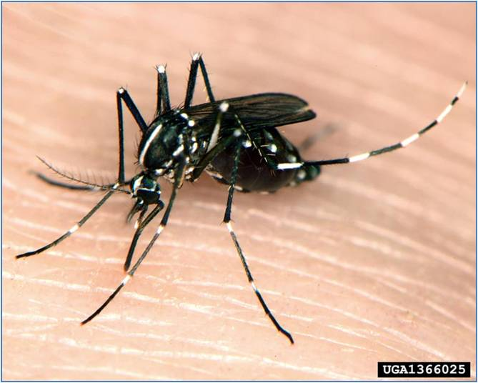
Rift Valley Fever Virus (RVF)
Primary transmission to humans: direct or indirect contact with blood or organs of infected animals.
Mosquito vector (Aedes)
No urban outbreaks
Photo Credit: Susan Ellis, Maryland, http://www.bugwood.org/
Notes:
Possible infection by humans has also been reported through the consumption of unpasteurized or uncooked milk. Aerosols produced during the slaughter of infected animals has been show as a transmission method. Other blood feeding flies can also serve as vectors. No human-to-human transmission reported. Most human cases are mild and fatalities are low.

Slide 29
USDA APHIS VS Select Agents and Toxins
28 as of May 2010

Slide 30
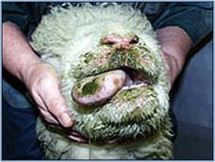
Bluetongue Virus
24 Serotypes
Transmitted by Culicoides
Affects sheep, cattle, and other ruminant animals
BTV’s have been problematic for the U.S. in terms of trade with Australia, New Zealand, and the EU
Photo: http://www.bluetonguevirus.org/about-bluetongue
Notes:
Bluetongue is also a dsRNA
First described in Africa in the late 18th century, but not described until 1905. OIE List A disease that has the capability of spreading. Prior to 1998, Europe was basically BTV-free. Genetic analysis of bluetongue viruses isolated in Europe has shown that six types of the virus (1, 2, 4, 8 9 and 16) have entered the region since 1998. The severity of signs in an animal infected with
bluetongue viruses depends on the virus serotype,
the infecting dose of virus, and the age, condition,
and resistance of the animal. Bluetongue should be
suspected when a number of sheep or cattle show
several of the following signs:
• Depression with heavy breathing or panting;
• High fever;
• Superficial hemorrhages or open sores or
vesicles on the tongue, mouth, or nostrils;
• Redness of the skin, face, neck, and possibly
body;
• Lameness accompanied by an engorged red
dish–blue area around the base of the horns and
on the coronary bands of the feet;
• Loss of condition and muscular weakness;
• Loss of wool.
Bluetongue disease is not severe in cattle; less
than 5 percent of adult animals usually show signs of
disease. When clinical illness does occur in cattle, it
is similar to bluetongue in sheep, including foot
lesions, which could lead to confusion with
foot–and–mouth disease. Bluetongue in cattle also
closely resembles or may be identical to a cattle
disease in parts of the United States known as
“myotic stomatitis.”
Goats are more resistant to bluetongue viruses
than sheep or cattle. However, some cases of
disease in goats with signs resembling those in
sheep have been reported, and bluetongue viruses
have been isolated from goats.
White–tailed deer and pronghorn in the United
States are affected much more severely than cattle
and often even more severely than sheep. In deer
and pronghorn, the mortality rate can be extremely
high. Bluetongue signs in white–tailed deer are
identical to those from infection with epizootic
hemorrhagic disease (EHD) viruses. Both bluetongue
and EHD virus infections cause a fulminating
hemorrhagic disease and sudden death in
white–tailed deer.
However, a relatively high number of cattle have been affected during the current outbreak in Northern Europe.
There is no treatment for bluetongue. Prevention may be possible by vaccination and by controlling midge populations (with insecticides or, where practical, by control of breeding sites), but neither is totally successful.
In August 2006, Dutch authorities reported the first ever case of bluetongue in Northern Europe (ProMED-mail report 20060818.2311). From work performed at the Institute for Animal Health at Pirbright, by the Arbovirus Research Group and the Community Reference Laboratory for bluetongue virus (BTV), the outbreak virus was rapidly identified as serotype 8. It subsequently spread to over 2,000 herds, mostly in the Netherlands, Belgium and Germany with a handful of cases in France and Luxembourg (see map (PDF)) before transmission ceased in the winter. The route by which the virus was introduced into northern Europe remains unknown.
A more detailed analysis of the BTV-8 outbreak in 2006 is available from EFSA
The 2007 re-emergence
On the 13th of June, a sentinel animal on a holding in North Rhein-Westphalia was announced to have displayed evidence of infection with bluetongue virus (BTV) serotype 8 during April (ProMED-mail report 20070613.1928). This was the first indication that the virus strain responsible for the outbreak in northern Europe last year had successfully overwintered in the region. The virus subsequently resurfaced in all countries affected in 2006, with new cases occurring for the first time in Denmark (ProMED-mail report 20071013.3360) and Switzerland (ProMED-mail report 20071028.3504), and the Czech Republic (first case 26th November; see OIE report (PDF)), as well as the UK.
Bluetongue in Europe in 2008
On 22 January, post-import testing indicated that a number of dairy cattle imported from the Netherlands into Northern Ireland had become PCR-positive since importation. Although these events are more fully described in [7] below, in brief they suggest that the strain of BTV-8 currently active in northern Europe may be able to cross the placenta and infect the foetus (as well as the possibility of oral infection). This may help to explain its ability to survive the relatively cold winters in northern Europe; see this recent IAH publication for a critical review of other potential mechanisms.
This year, BTV-8 has re-emerged across much of its previous range, and has continued to spread rapidly in some areas – particularly France, which had over 15,000 new cases by 1st October (link (PDF)). Belgium, France, Germany, Luxembourg, the Netherlands and Switzerland have declared to OIE that they now consider BTV-8 to be endemic within their countries. The presence of BTV-8 has also been confirmed for the first time in Sweden (in September; see OIE report), Hungary (in September; see SCFCAH report (PDF)), and Italy (see OIE report), while surveillance zones now include parts of Poland and Romania.
Several companies have also started production of a vaccine against BTV-8, and most countries affected by the virus have since begun national vaccination campaigns. More recently, other bluetongue serotypes have also been detected. BTV-1 has continued to spread north since its detection in Morocco in 2006. Its range now overlaps significantly with that of BTV-8 in France and Spain (as shown on this map; last updated 2008-11-07). Meanwhile, on 24 October, the Arbovirus Research Group and EU reference laboratory at IAH Pirbright confirmed the presence of BTV-6 in the Netherlands. Finally, Swiss authorities have detected an entirely new type of bluetongue-like virus in goats. The virus was initially called Toggenburg Orbivirus (TOV), but based on genetic analysis, its finders have proposed that it should be classified as a new serotype of bluetongue, bringing the total number of serotypes known to 25. Further information can be found in this article (PDF).
In October and November the Netherlands and Germany reported laboratory findings of BTV6 circulation in cattle located in neighbouring parts of their territories.Information on the genetic sequence available from the virus isolates indicated a high similarity with the BTV6 South African modified live vaccine and investigations suggest that no virulent BTV6 virus strain circulated in the Netherlands or Germany (PROMED-mail report 20090304.0888).
Bluetongue in Europe in 2009
In February BTV-11 infected cattle were discovered in 8 farms in provinces of Flemish Brabant, Antwerp and Limburg, Belgium (PROMED-mail report 20090218.0684 ). Following investigations it was decided that this was an escape of a non-virulent African vaccine strain similar to the outbreak of BTV6 in The Netherlands/Germany late in 2008. Also in February routine tests identified BTV8 infection in 2 herds in the south of Norway (PROMED-mail report 20090221.0729).

Slide 31
USDA APHIS PPQ Select Agents and Toxins
8 as of May 2010

Slide 32
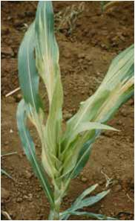
Philippine Downy Mildew, Peronosclerospora philippinensis
Asia, Africa
Maize, Oats, Sugarcane, Sorghum
Chlorotic striping
Downy growth on or under leaf surface
Source of Photo and Information: http://apps.cimmyt.org/english/docs/
field_guides/maize/pdf/mzDis_foliar.pdf
Notes:
These diseases are of serious concern to maize
producers in several countries of Asia, Africa, and
throughout the Americas. Symptom expression is
greatly affected by plant age, pathogen species, and
environment. Usually, there is chlorotic striping or
partial symptoms in leaves and leaf sheaths, along
with dwarfing. Downy mildew becomes conspicuous
after development of a downy growth on or under
leaf surfaces. This condition is the result of conidia
formation, which commonly occurs in the early
morning.
The diseases are most prevalent in warm, humid
regions. Some species causing downy mildew also
induce tassel malformations, blocking pollen
production and ear formation. Leaves may be
narrow, thick, and abnormally erect.

Slide 33
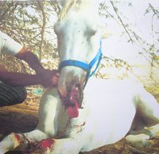
20th Century Agroterrorism
Germany, WWI
Infected horses shipped to Europe with Anthrax and Glanders
Both diseases are on the USDA and HHS list for select agents
Source of Photo: http://www.facebook.com/pages/Stop-Glanders-in-Bahrain/112929715415056
Notes:
Source of image-Stop Glanders in Bahrain facebook page. http://www.facebook.com/pages/Stop-Glanders-in-Bahrain/112929715415056
Current OIE bahrain outbreak information available at: http://www.oie.int/wahis/public.php?page=single_report&pop=1&reportid=9239
Glanders CDC page is available at: http://www.cdc.gov/nczved/divisions/dfbmd/diseases/glanders/

Slide 34
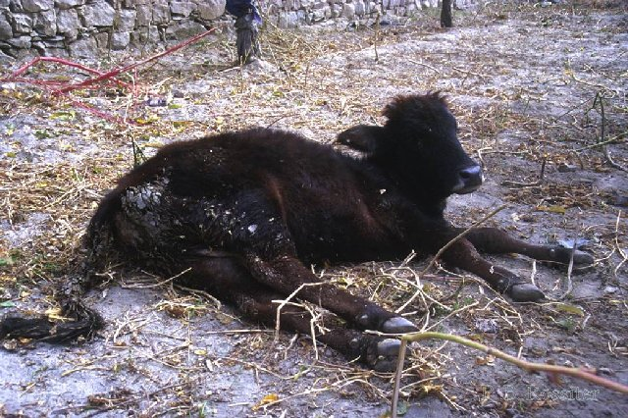
20th Century Agroterrorism
Japan, WWII
Accused of using anthrax and rinderpest
Rinderpest virus is on the USDA select agent and toxin list
Source of Photo: http://www.cvm.tamu.edu/fadr/Disease.aspx?DID=3400
Notes:
During WWII, Japan was accused of using anthrax and rinderpest virus against Russia and Mongolia.
Source of Information: http://www.cidrap.umn.edu/cidrap/content/biosecurity/ag-biosec/biofacts/agbiooview.html

Slide 35
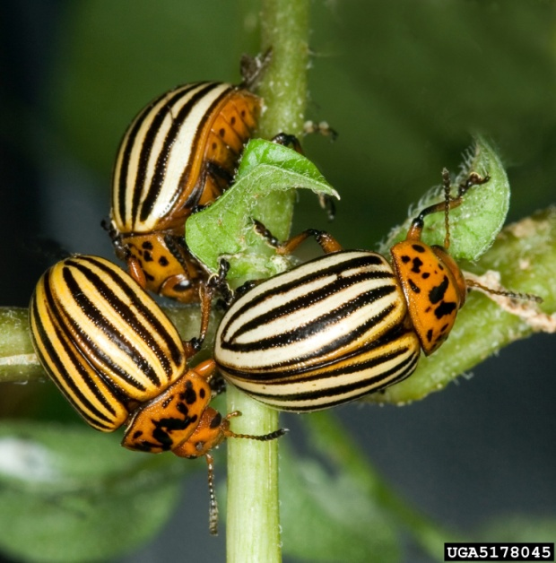
20th Century Agroterrorism
Germany, WWII
Accused of dropping cartons of Colorado Potato Beetle in Southern England
Image of Colorado Potato Beetle, Leptinotarsa decemlineata, by David Cappaert,
Michigan State University, http://www.bugwood.org/ Image No. 5178045

Slide 36
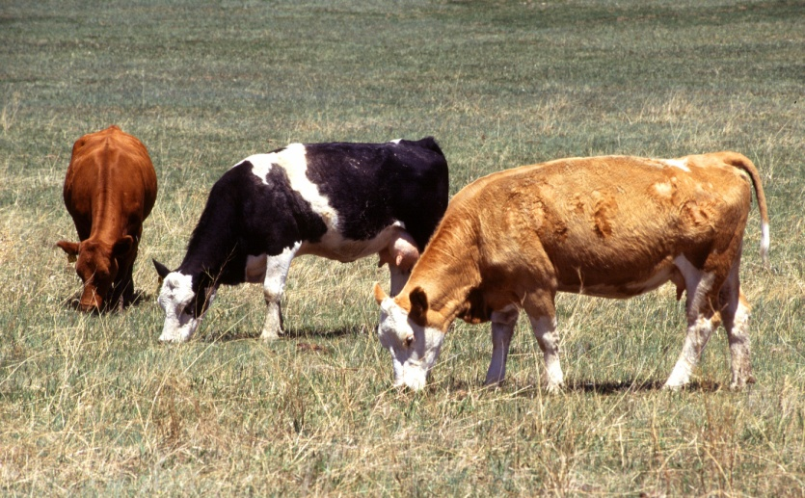
20th Century Agroterrorism
1952
The Mau Mau killed 33 head of cattle in Kenya
African bush milk
Photo Credit: Scott Bauer, USDA ARS
http://www.ars.usda.gov/is/graphics/photos/, Image No. K7686-7
Notes:
African bush milk is a locally occurring plant toxin.

Slide 37
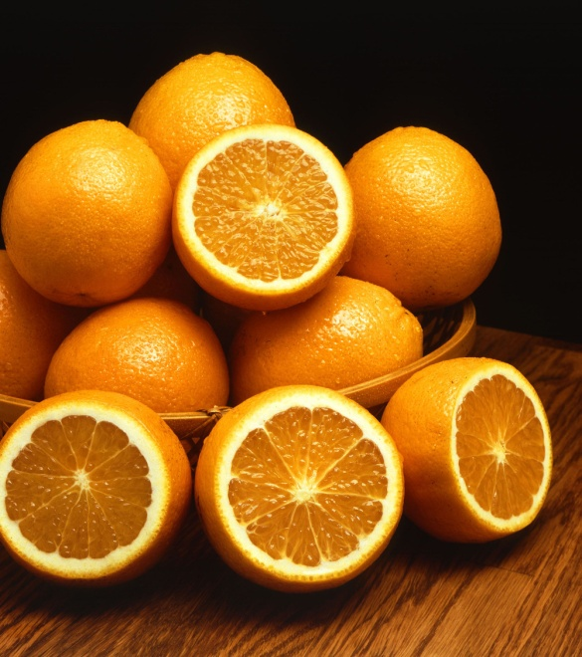
20th Century Agroterrorism
1978, Arab Revolutionary Council
Mercury to poison Israeli oranges
12 people injured, and a 40% reduction in exports
Photo Credit: USDA ARS Photo Gallery
http://www.ars.usda.gov/is/graphics/photos/, Image No. K3644-12

Slide 38
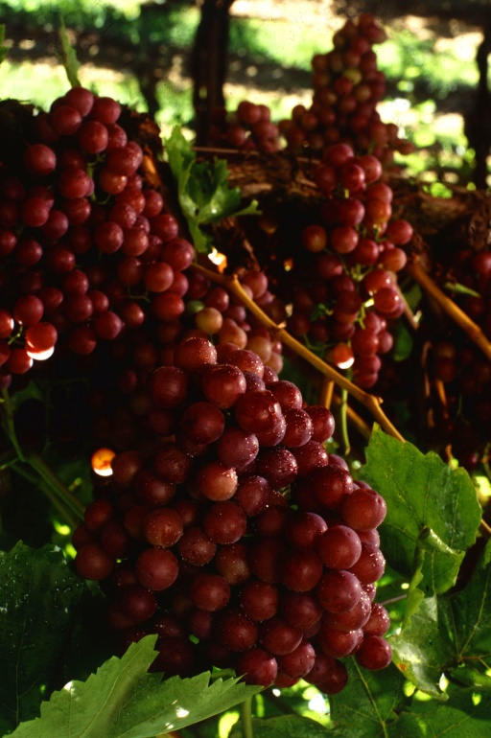
20th Century Agroterrorism
1997, Israeli individuals in Gosh Etzion
Sprayed pesticides on grapevines in two Palestine villages
~17,000 metric tons of grapes destroyed
Photo Credit: USDA ARS Photo Gallery, Patrick Tregenza
http://www.ars.usda.gov/is/graphics/photos/, Image No. K5632-3

Slide 39
20th Century Agricultural Bioweapons Programs
Canada, 1940s-1960s
France, 1939-1972
Former Soviet Union, 1935-1992
Germany, 1915-1917
Iraq, 1980s-unknown
Japan, 1937-1945
South Africa,
1980s 1993
United Kingdom, 1937-1960s
United States,
1943-1969
Source of Information: http://www.cidrap.umn.edu/cidrap/content/biosecurity/
ag-biosec/biofacts/agbiooview.html

Slide 40
Additional Reference
Gullino, M.L., J. Fletcher, and J.P. Stack. Crop Biosecurity: Definitions and Role in Food Safety and Food Security. 2008. In Crop Biosecurity: Assuring our Global Food Supply. Gullino, M.L., J. Fletcher, A. Gamliel, J.P. Stack (eds). Springer. Pp. 1-10.
Center for Infectious Disease Research and Policy, University of Minnesota http://www.cidrap.umn.edu/cidrap/content/biosecurity/ag-biosec/biofacts/agbiooview.html

Slide 41
Class Discussion Topics
Which of the Select Agents discussed today (Ricin, Rift Valley Fever Virus, Bluetongue Virus, and Philippine Downy Mildew) poses the greatest biosecurity risk to the U.S.? Why?
Who are the stakeholders in a biosecurity event?
In an editorial article by Graham and Talent entitled Bioterrorism: Redefining Prevention (Source: 2009 Vol. 7, No. 2, Biosecurity and Bioterrorism: Biodefense Strategy, Practice, and Science) state that “terrorists are more likely to obtain and use a biological weapon than a nuclear weapon”. Do you agree or disagree with this statement?

